Slide 1
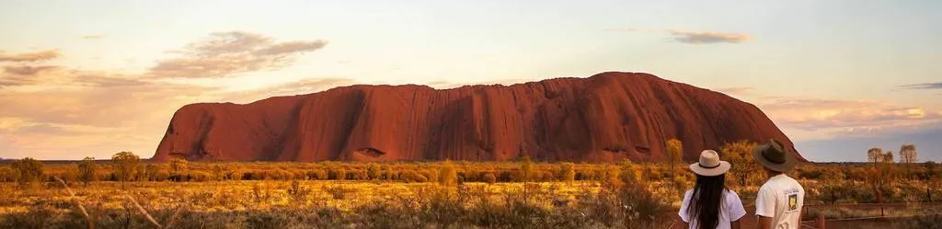
KAAN Group
The Future of The NT Tourism
Source: Todoroski, C. (2025, January 13)

Slide 2
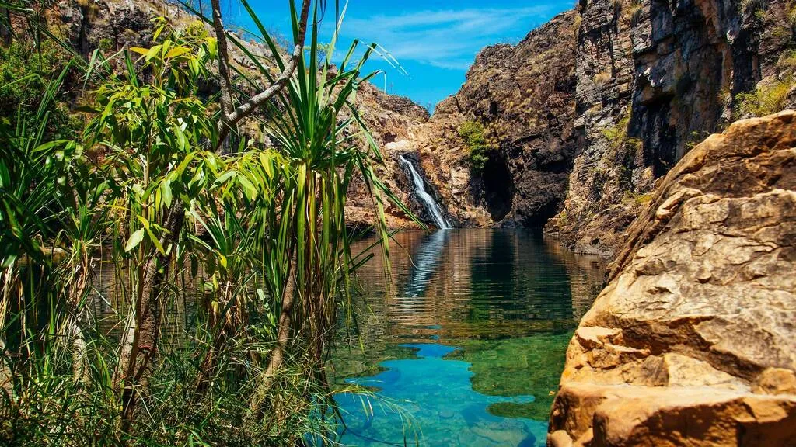
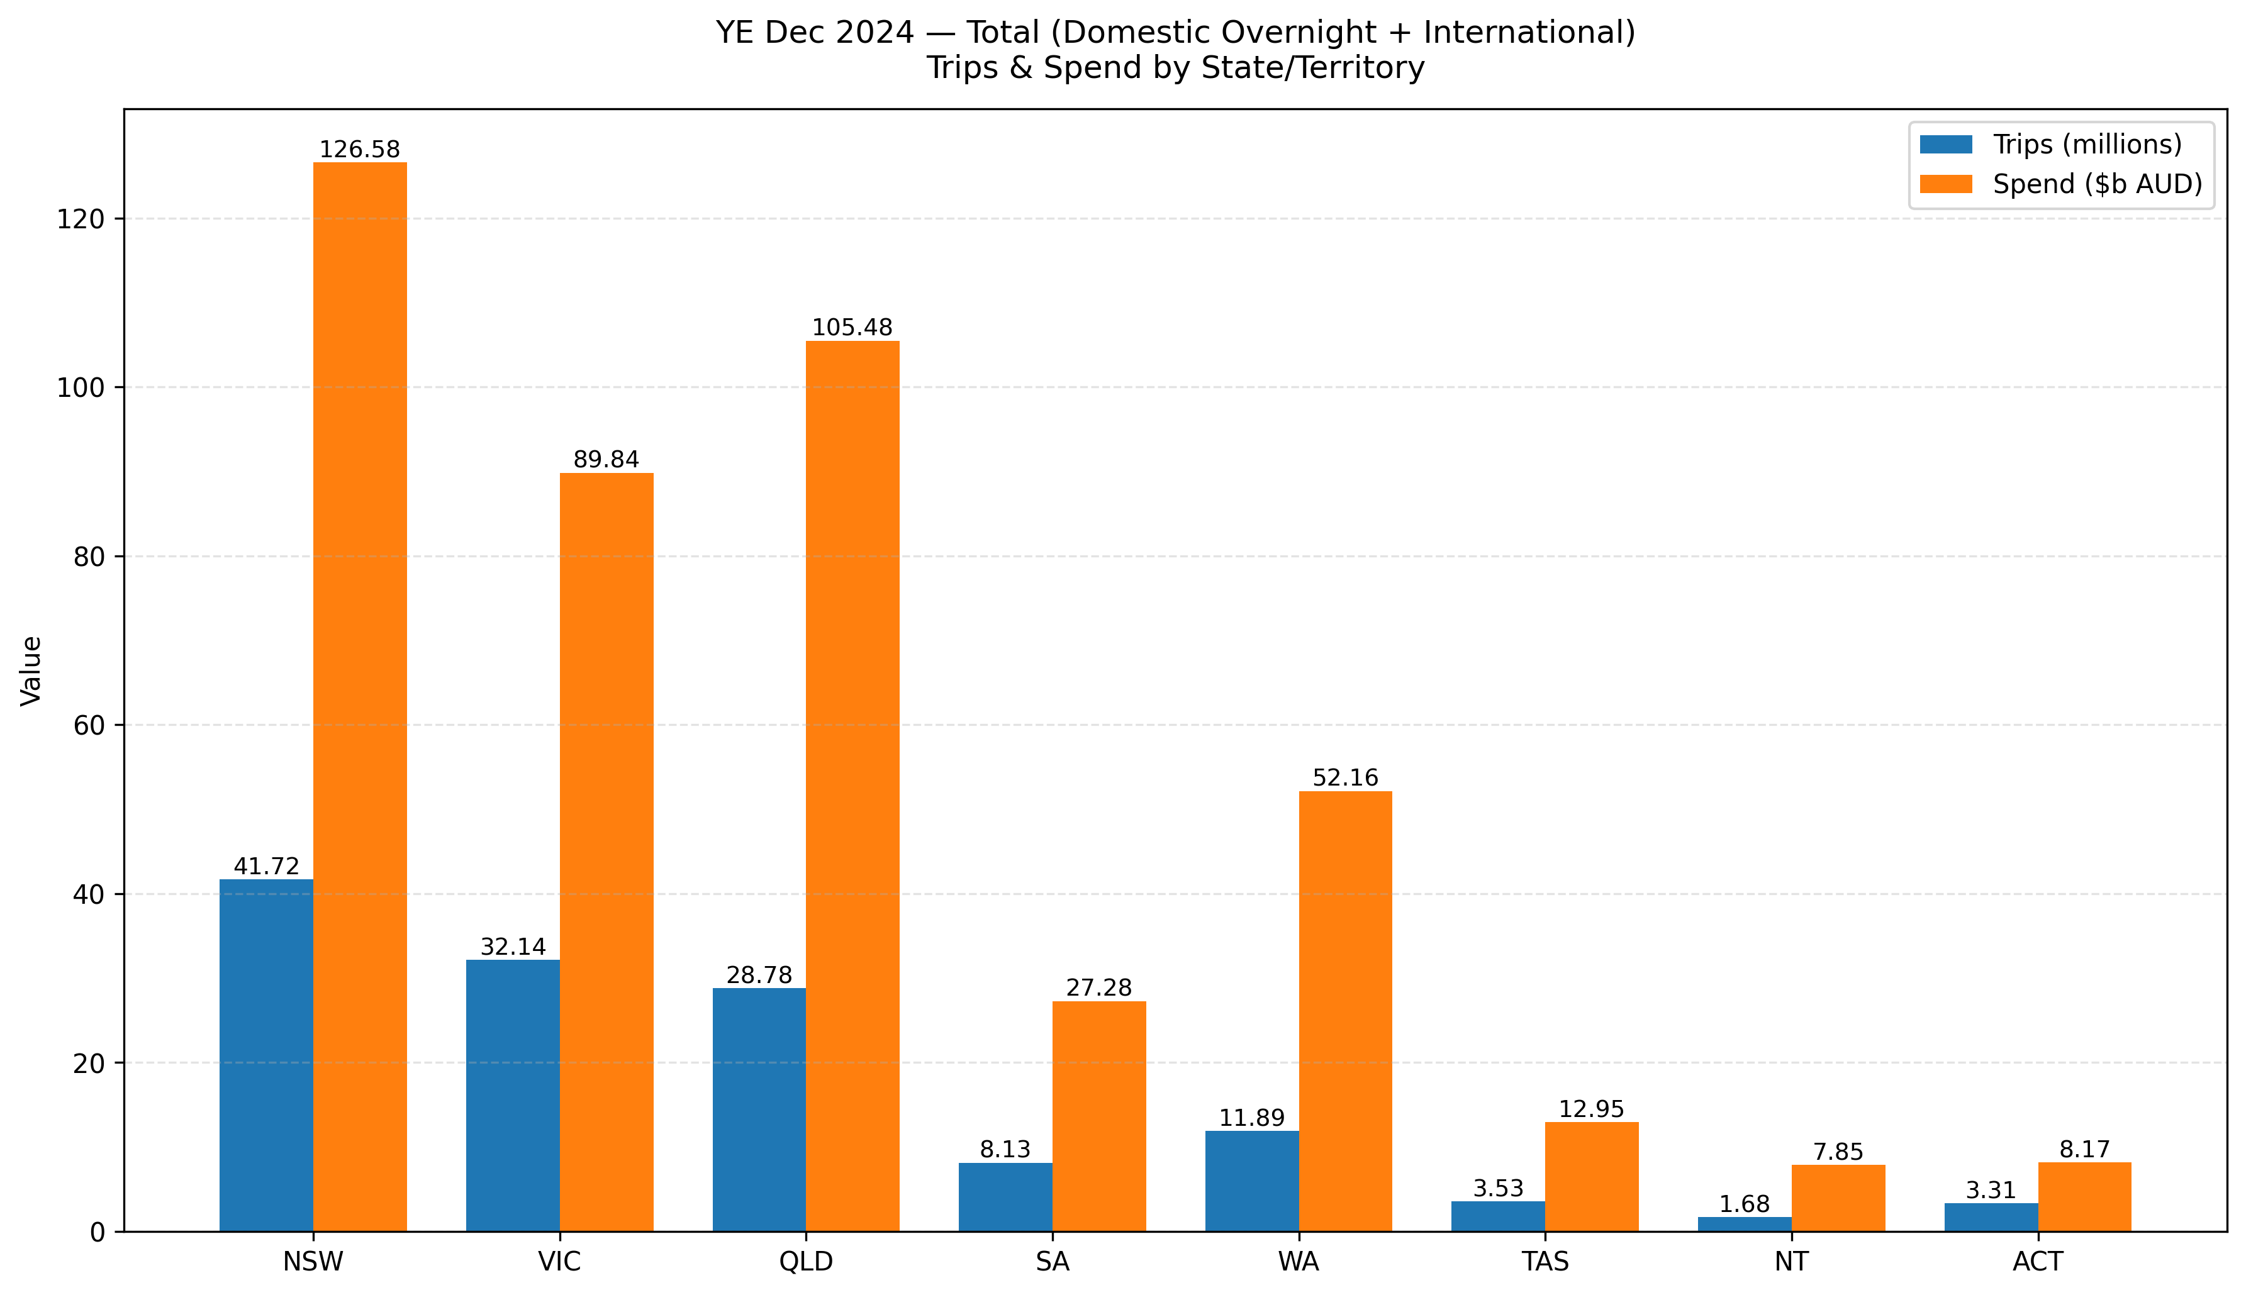
Background
Tourism in the Northern Territory (NT)
Population: 263,400 (as of Mar 2025)
Visitors: 1.64 million (2024 Calendar Year)
Tourism Revenue: $7.85 billion
The Challenge
Many experiences are not captured in reviews.
Reviews are fragmented across multiple platforms.
Hard to measure visitor satisfaction and pain points at scale.
NT has the lowest domestic & international visits and expenditure among all Australian states (2024).
Why Reviews Matter
Higher review coverage (reviews/visitors) = more insight on a personal scale.
Helps assess experience quality by sector and region.
Supports better marketing and service decisions.
Source: (Australian Bureau of Statistics, 2025) & (NT Tourism 2024)
Source: Todoroski, C. (2025, January 13)

Slide 3

Goals
Discovering factors that affect tourism by collected and analysed reviews.
Give recommendations based on tourist reviews analysed.
Can we predict the tourist average rating?
Source: Todoroski, C. (2025, January 13)

Slide 4
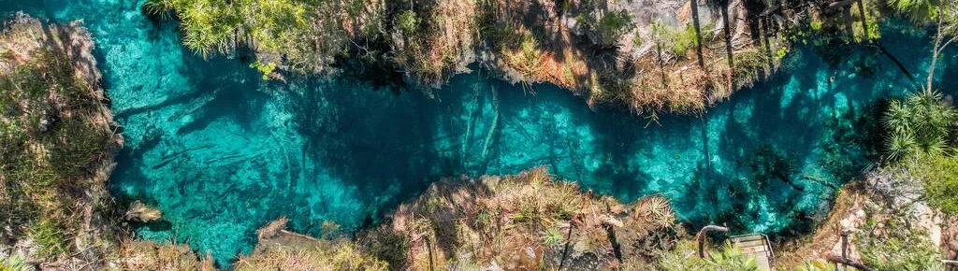
Methodology
Data Collection
Data Preparation
Limitations
Sentiment analysis
Exploratory Data Analysis
Text analysis
Results
Recommendations
Source: Todoroski, C. (2025, January 13)

Slide 5
1. Data Collection
Data is scraped from Trip Advisor and Google Maps (from 01.01.2024 0 now) for
5 main categories
Entertainment: Activities (Tours, activities)
Accommodation: Hotel
Attractions: Tourist Attractions
Food & Beverage: Restaurant / Cafe
Shopping: Shoppingmall
Source: Apify review scraper
More than 7000 rows with features:
Categories
Star rating
Location (city, region)
Review / Title
Travel date
User Location

Slide 6
3. Data Preparation
Place information
User information
Review and sentiments
Categories (Activities, Hotel, Restaurant, Cafe …)
Place Region
Place location (City, Postal Code)
Place average star rating
User Location
Text and Title
Review Rating (from 1-5)
Review Published Date
Month travel
Review sentiment

Slide 7
Why Understanding Tourist Emotions Is Essential
Tourists don't just leave ratings; they share feelings. Uncovering these emotional tones reveals hidden satisfaction patterns that simple star ratings can't capture.
"Beautiful views, but the food was disappointing."
Understanding these emotions helps Northern Territory (NT) tourism stakeholders to:
Improve visitor experience by addressing specific pain points.
Identify emerging issues early, before they escalate.
Predict tourism growth trends based on genuine sentiment.

Slide 8
We Built a 7-Model Emotion Intelligence Framework
Final Emotion Decision
Large Language Model: Flan-T5 contextual reasoning
Lexicon (VADER): Rule-based sentiment cues
Multilingual: XLM-R cross-language signals
Deep Learning: Cardiff NLP RoBERTa
Emotion Models: Hartmann & GoEmotions
Aspect-based: PyABSA ATEPC insights

Slide 9
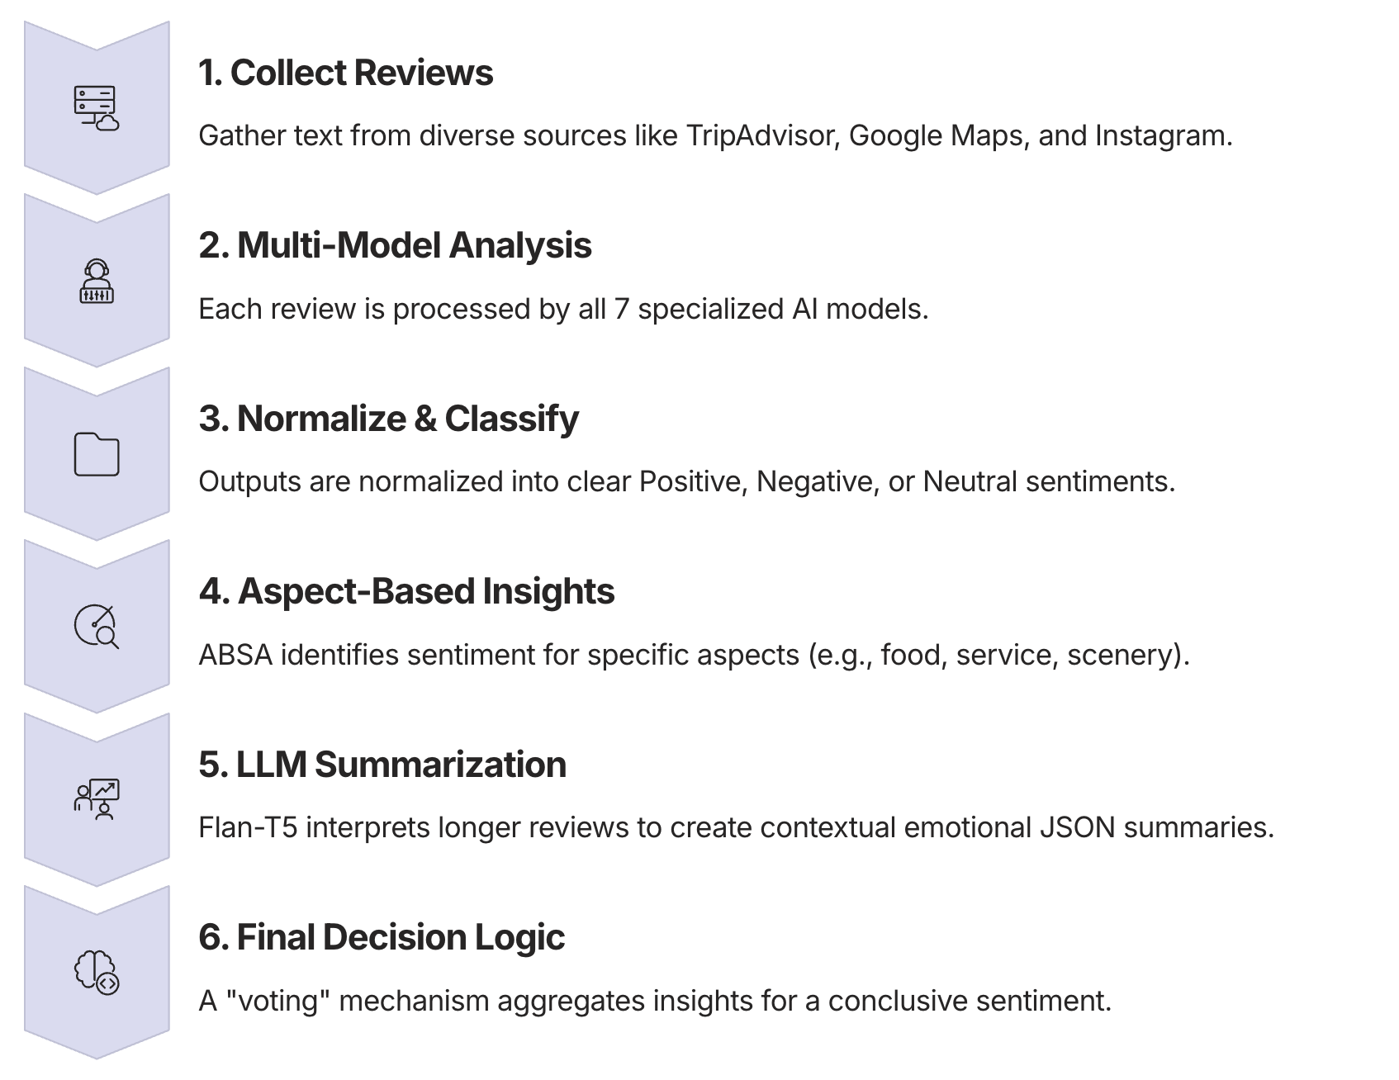
How the System Works Behind the Scenes
Our unified emotion pipeline transforms raw review data into actionable insights through a systematic, multi-stage process.

Slide 10
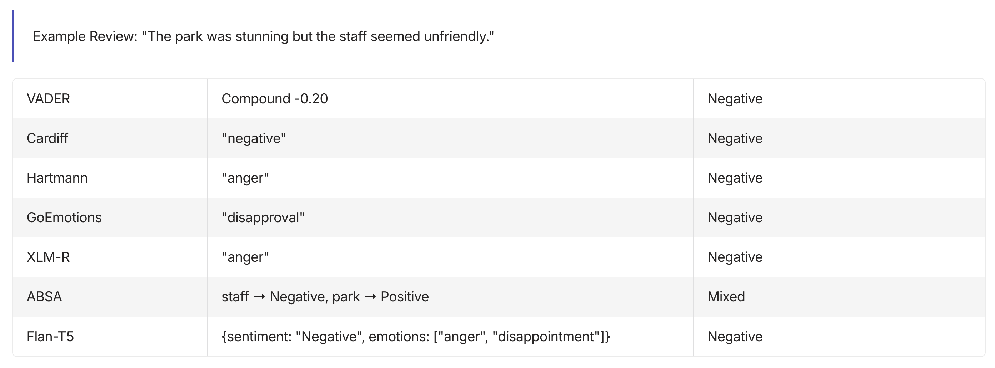
How Models Interpret the Same Review Differently
A single review can evoke varied interpretations across our models, highlighting the necessity of a multi-model approach for comprehensive understanding.

Slide 11





Majority-Vote + Context Weighting = Our Fusion Logic
Collect Model Votes
Each model casts a "vote" for Positive, Negative, or Neutral sentiment.
Aspect Weighting
ABSA's aspect-based insights provide multiple votes for distinct elements within a single review.
LLM as Tie-Breaker
For complex cases or long reviews, Flan-T5's contextual understanding serves as the ultimate arbiter.
Unified Sentiment
The combined intelligence leads to a single, highly accurate emotional classification.

Slide 12
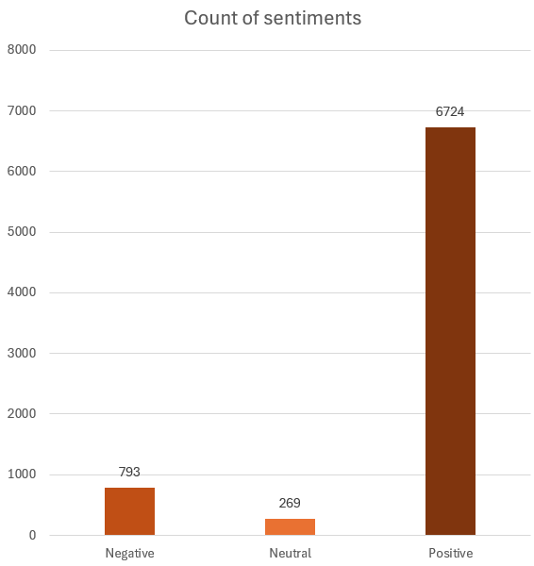
4. Exploratory Data Analysis
Distribution of sentiments
Positive sentiment outweighing the other two
Negative and neural reviews only makeup 16% of the total reviews.

Slide 13
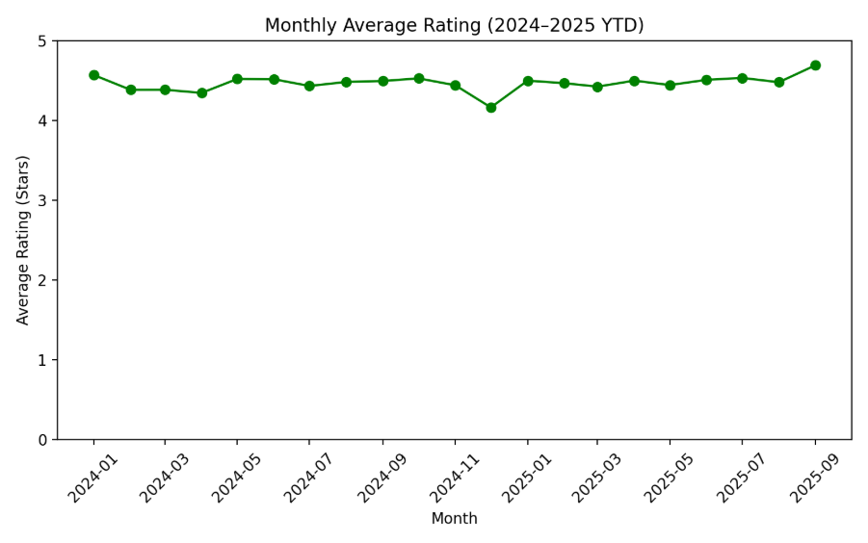
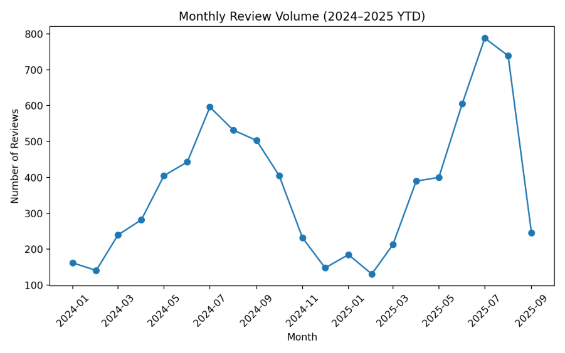
4. Average Rating & Review Count
However, the average rating stays moderately the same(above 4). This can be explained by the number of positive reviews overweight number of neutral and negative reviews
A high number of reviews peaked in July 2024, and through to October (dry season).
Big drop in Average rating and review count from November 2024 – February 2025 (wet season).

Slide 14
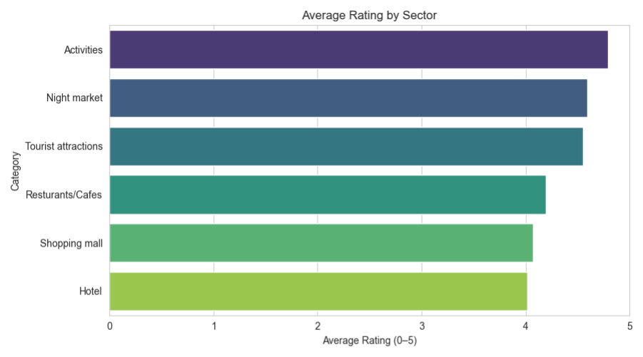
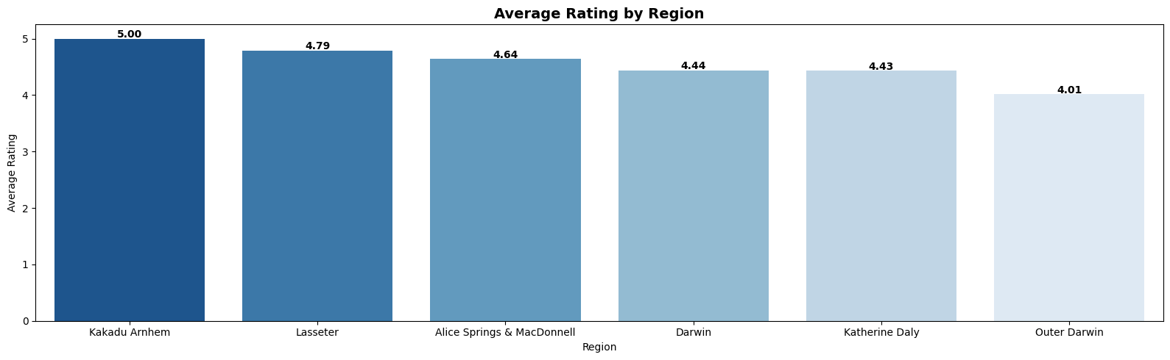
4.Avg Rating by Sector & Region
Hotels has the lowest average rating while Activities has the highest average rating (however there is a power imbalance between counts in sectors)
Average negative rating here for Hotels is influenced by: Bad reviews/bad sentiment/lower count
Kakadu Arnhem and Lasseter has the highest Average Rating however lowest review count in the dataset. Darwin has the highest Count and best standard rating of 4.44

Slide 15

2. Sentiment analysis
7 models was applied to classify the review sentiment:
VADER
Cardiff
Hartmann
GoEmotions
XLM-R
ABSA
Flan-T5
And Final Review sentiment:
Positive
Negative
Neutral
Source: Todoroski, C. (2025, January 13)

Slide 16
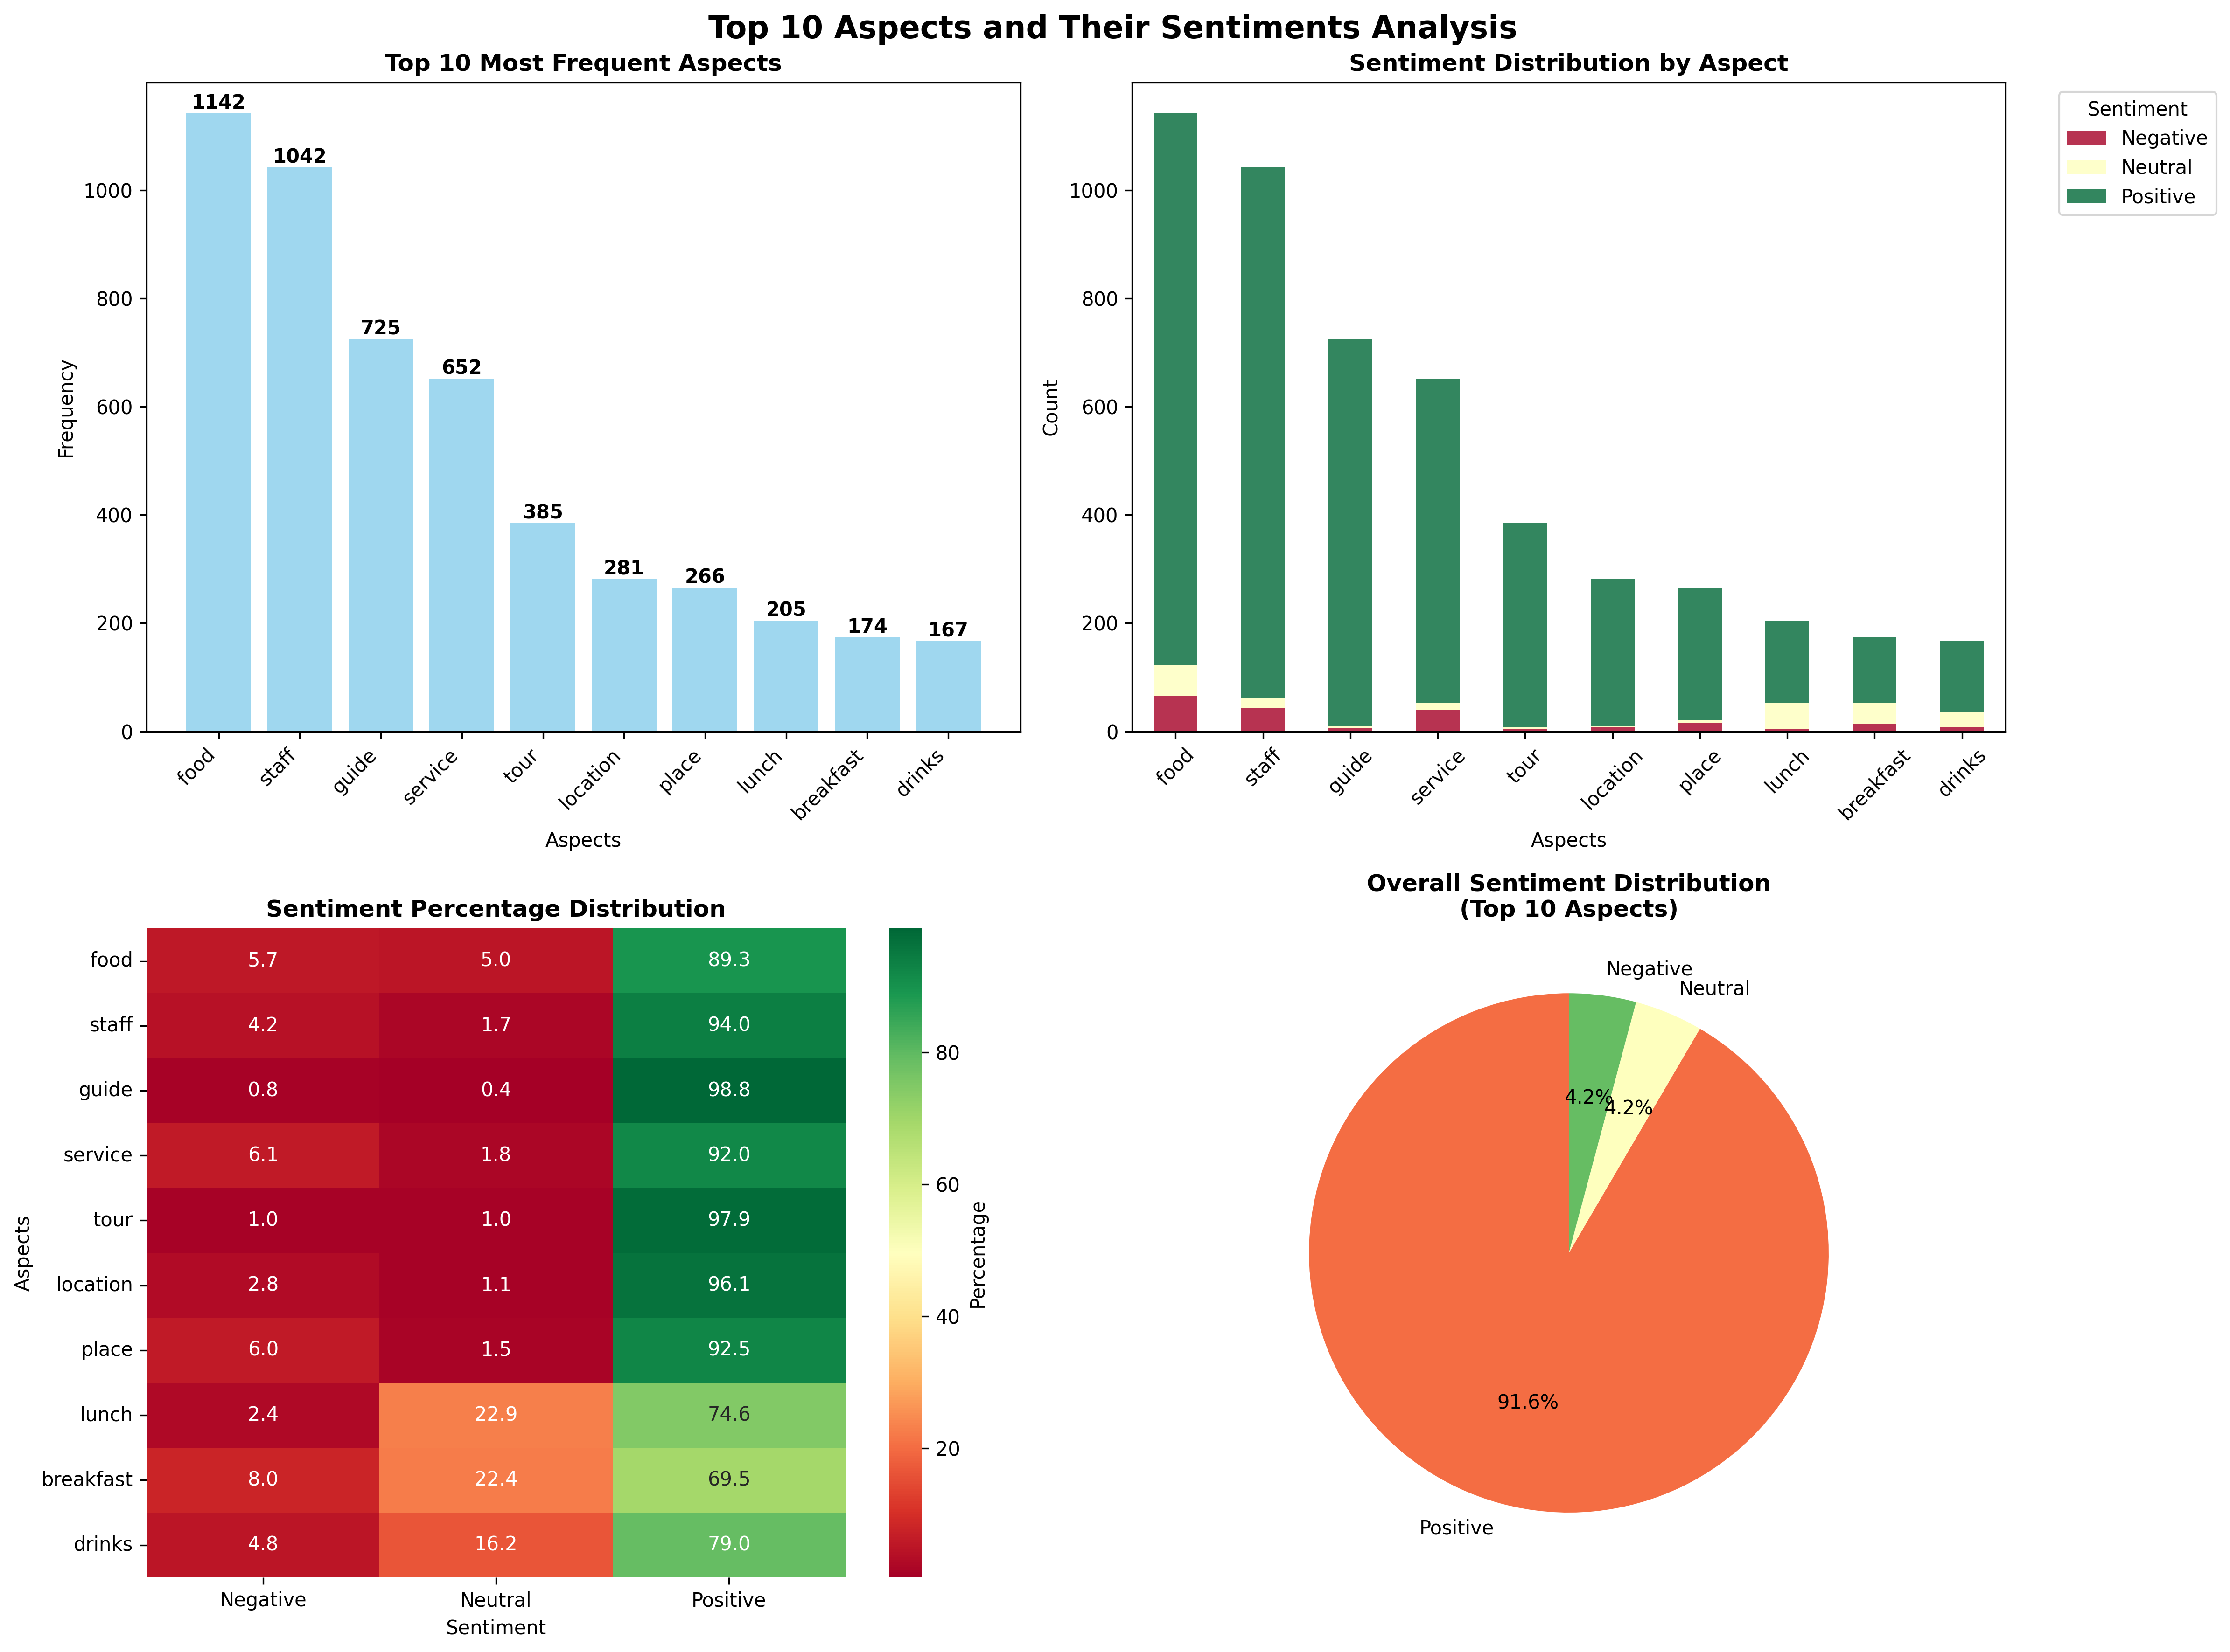
Sentiment Analysis
Positive:
Guide (98.8%) and Tour (97.9%) => Organised tourism experiences in the Northern Territory is highly rated
Staff (94%) and Service (92%) => Strengthen the image of the region as a place of friendly and welcoming locals.
Negative and Neutral:
Lunch (74.6% positive, 22.9% neutral) and Breakfast (69.5% positive, 22.4% neutral)
Drinks (79% positive, 16.2% neutral)
=> Meal quality remains an issue that requires improvement.

Slide 17
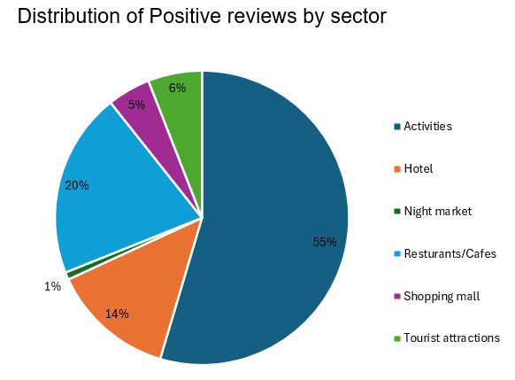
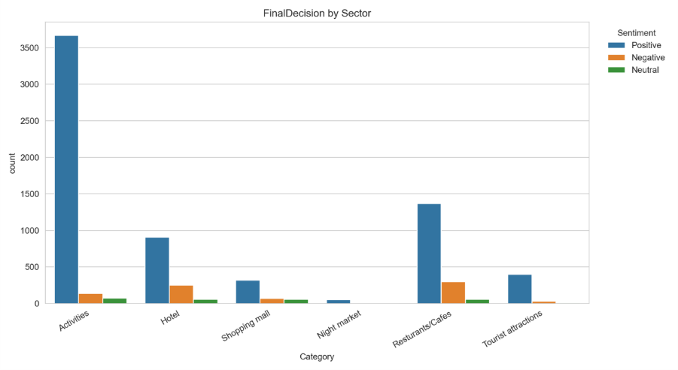
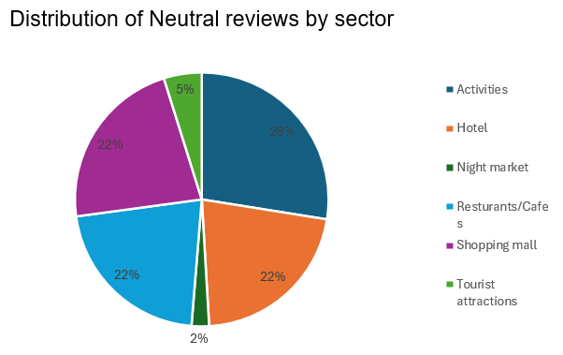
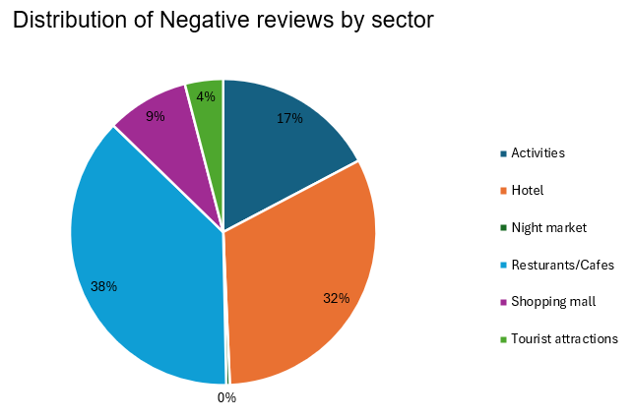
4. Distribution of Reviews
Negative reviews: Hotel and Restaurant/ Café
Positive reviews: Activities

Slide 18
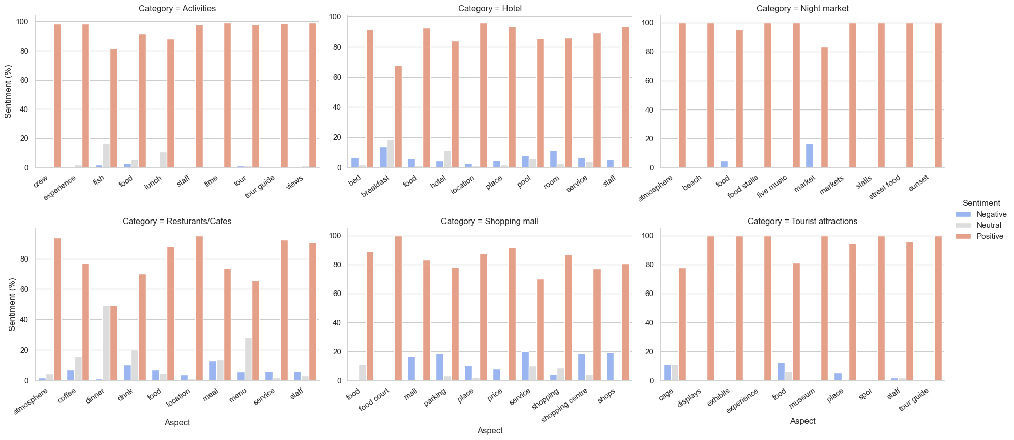
Top 10 words commented by category
Food, Facility, Service (Staff), Location

Slide 19
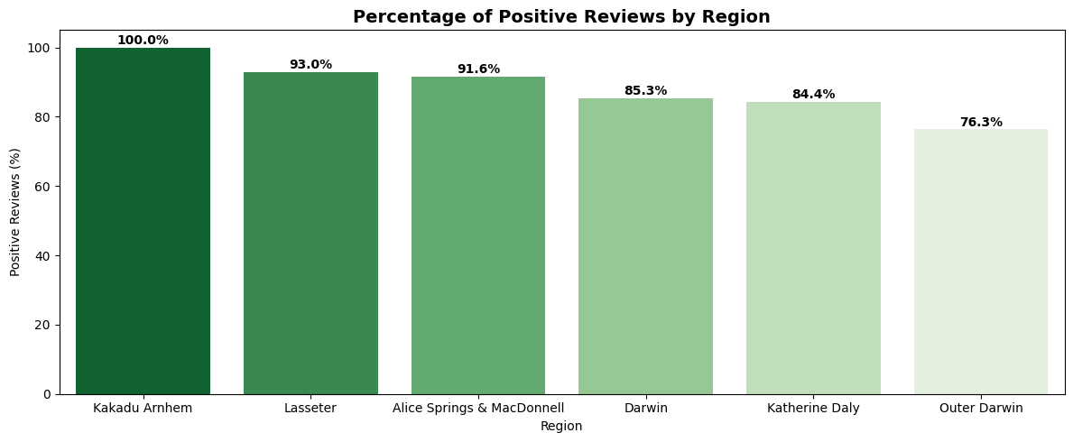
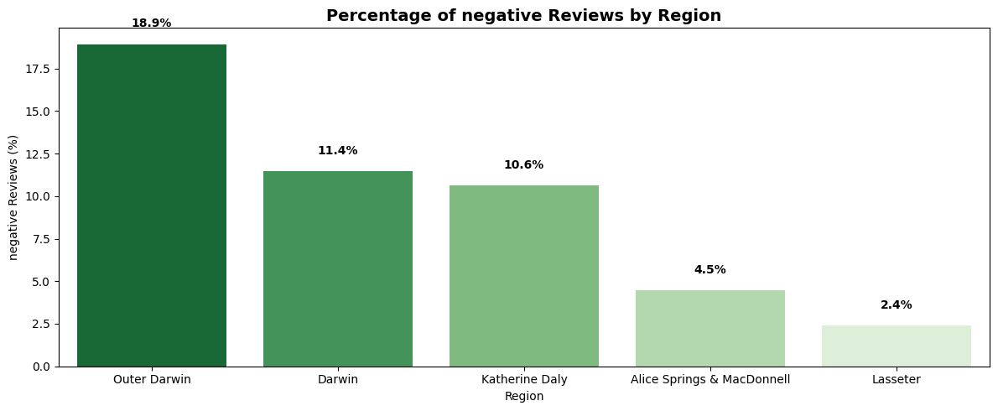
Polarity by Region
Negative reviews: Outer Darwin, Darwin, Katherine Daly
Positive reviews: Kakadu Lasseter (low count), Alice & Darwin.

Slide 20
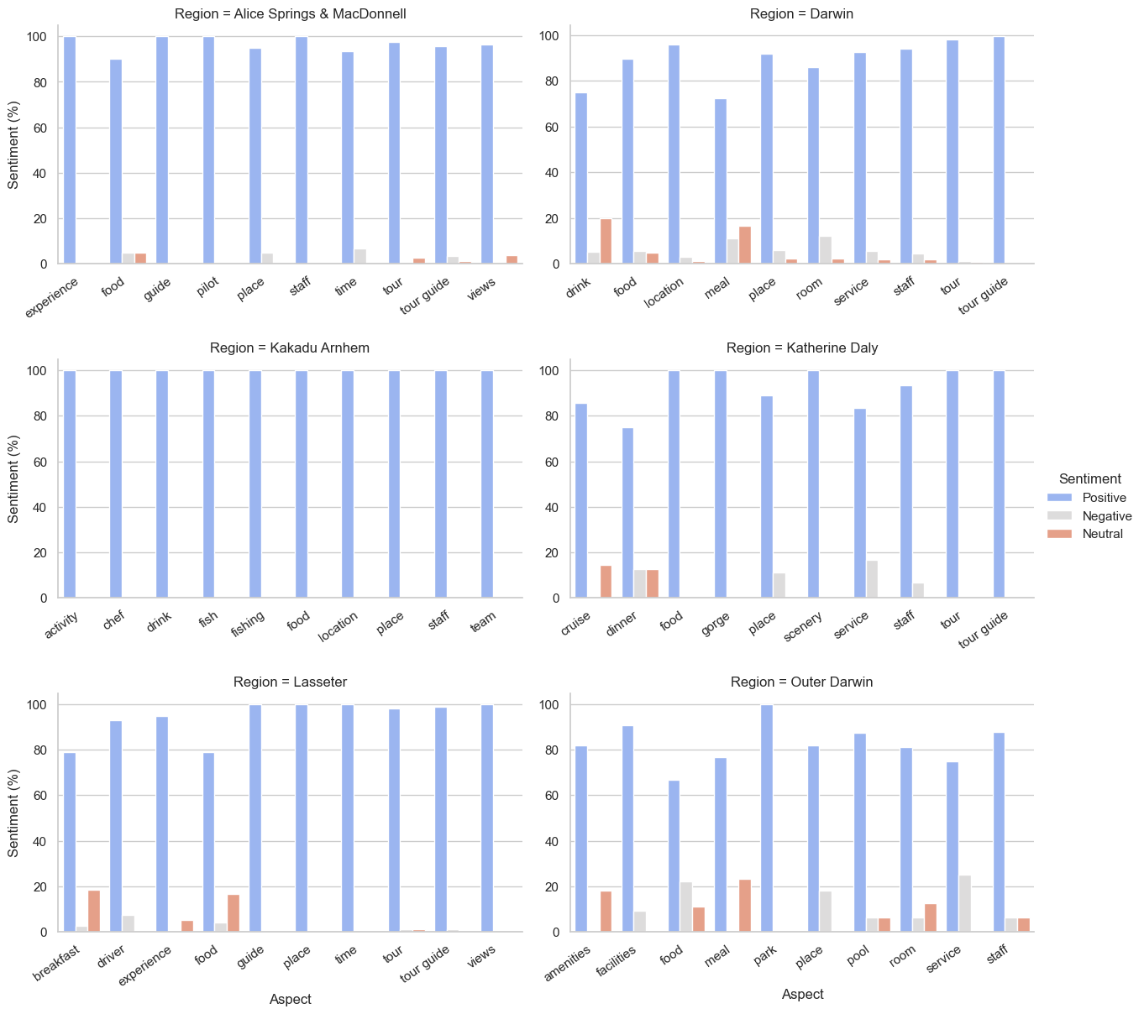
Sentiment analysis continued
Food, Facility, Service (Staff), Location

Slide 21
“What people feel often predicts what they spend.”
Review
Sentiment
Engagement
Economic Value

Slide 22
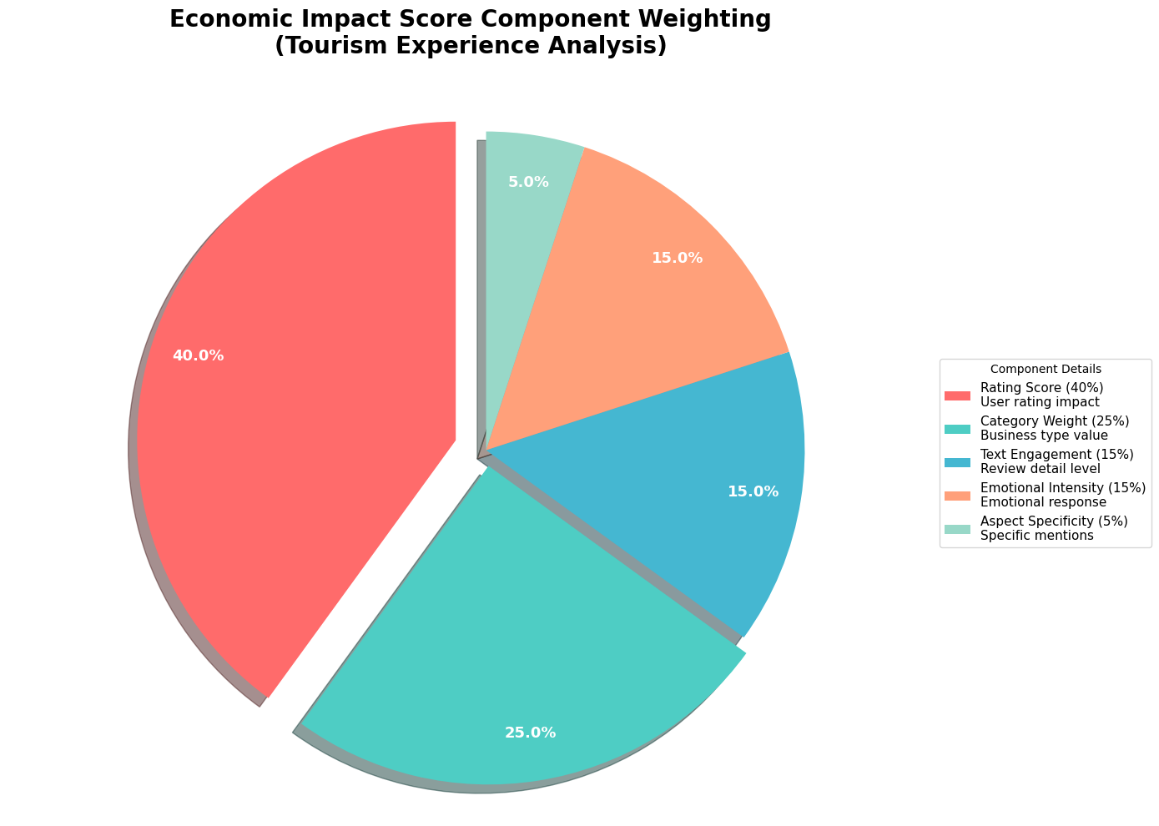

Slide 23
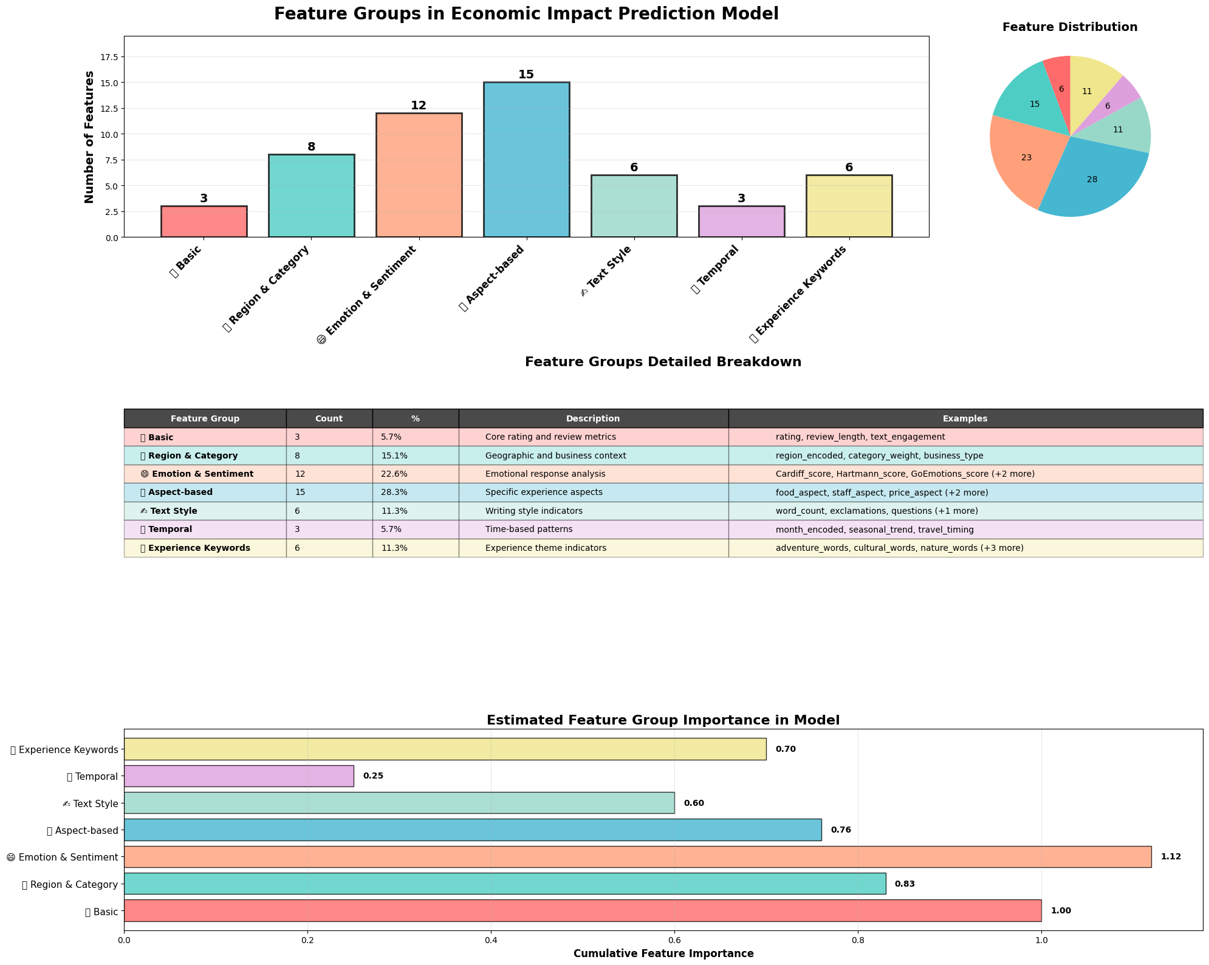

Slide 24
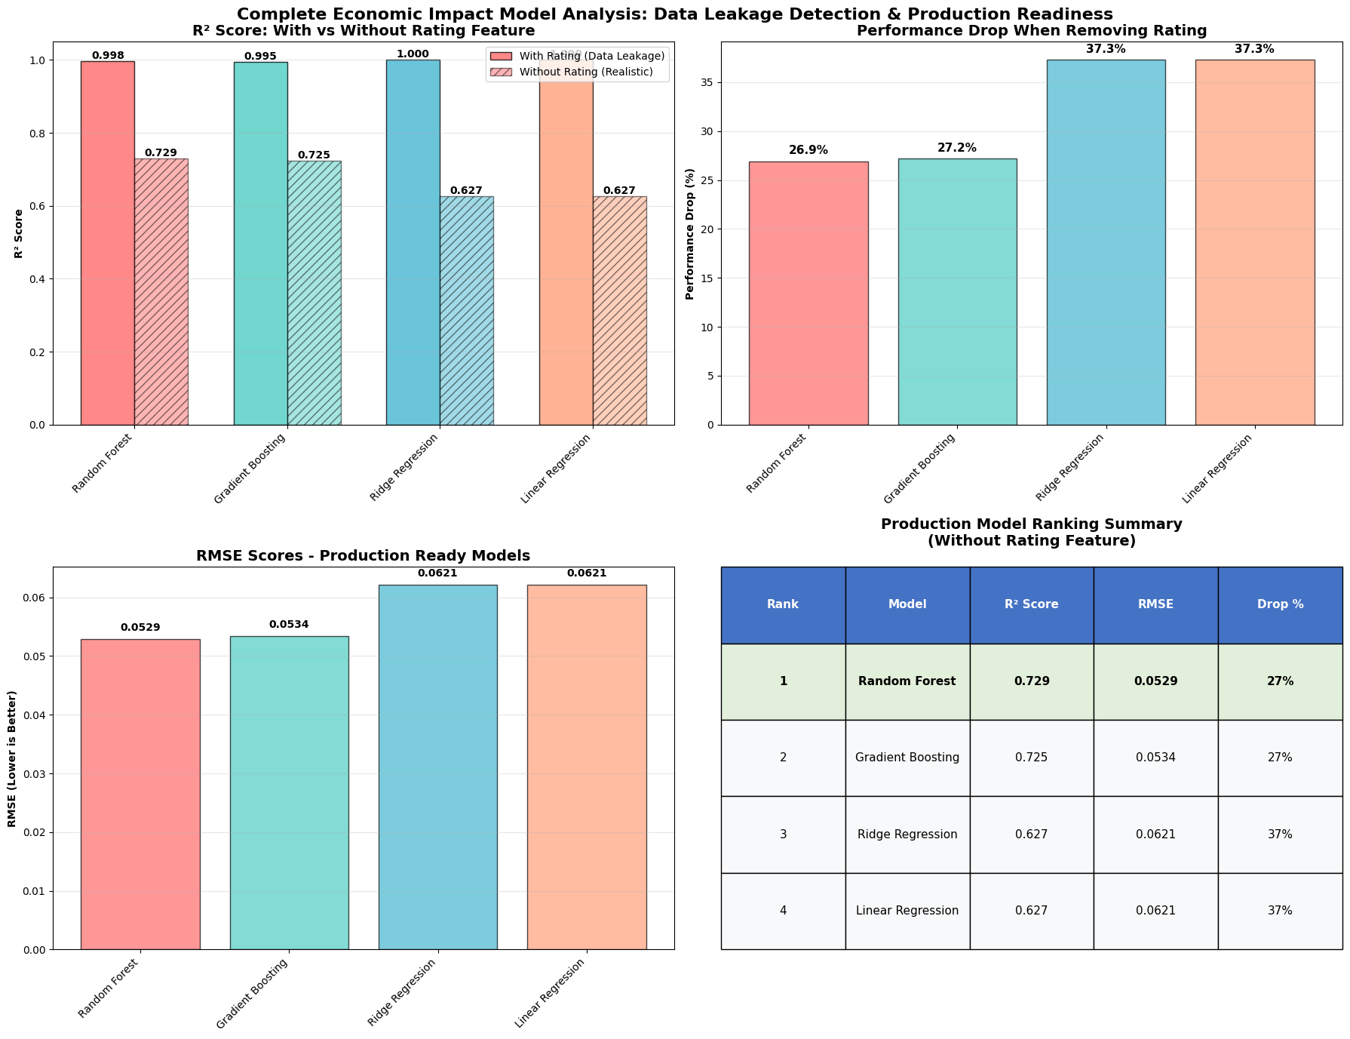

Slide 25
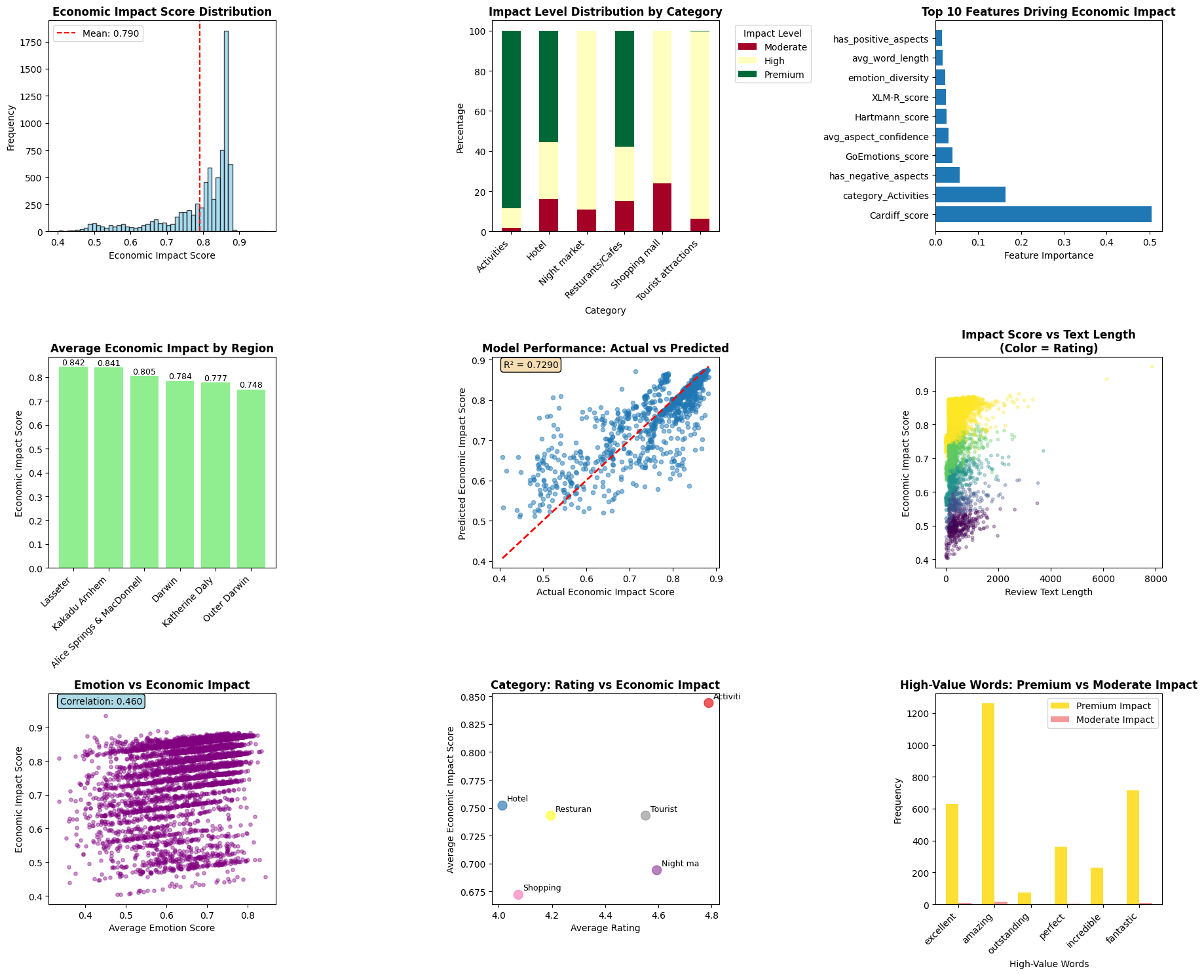

Slide 26

4. Limitations
Limitations
The count of reviews and the number of people visited the NT are not equal in Ratio
Our data is imbalanced in power ratio in terms of good : bad review.
Data is not collected equally based on category.

Slide 27
4. Recommendation
Takeaway:
FFSL
Food, facility, service and location (FFSL)

Slide 28
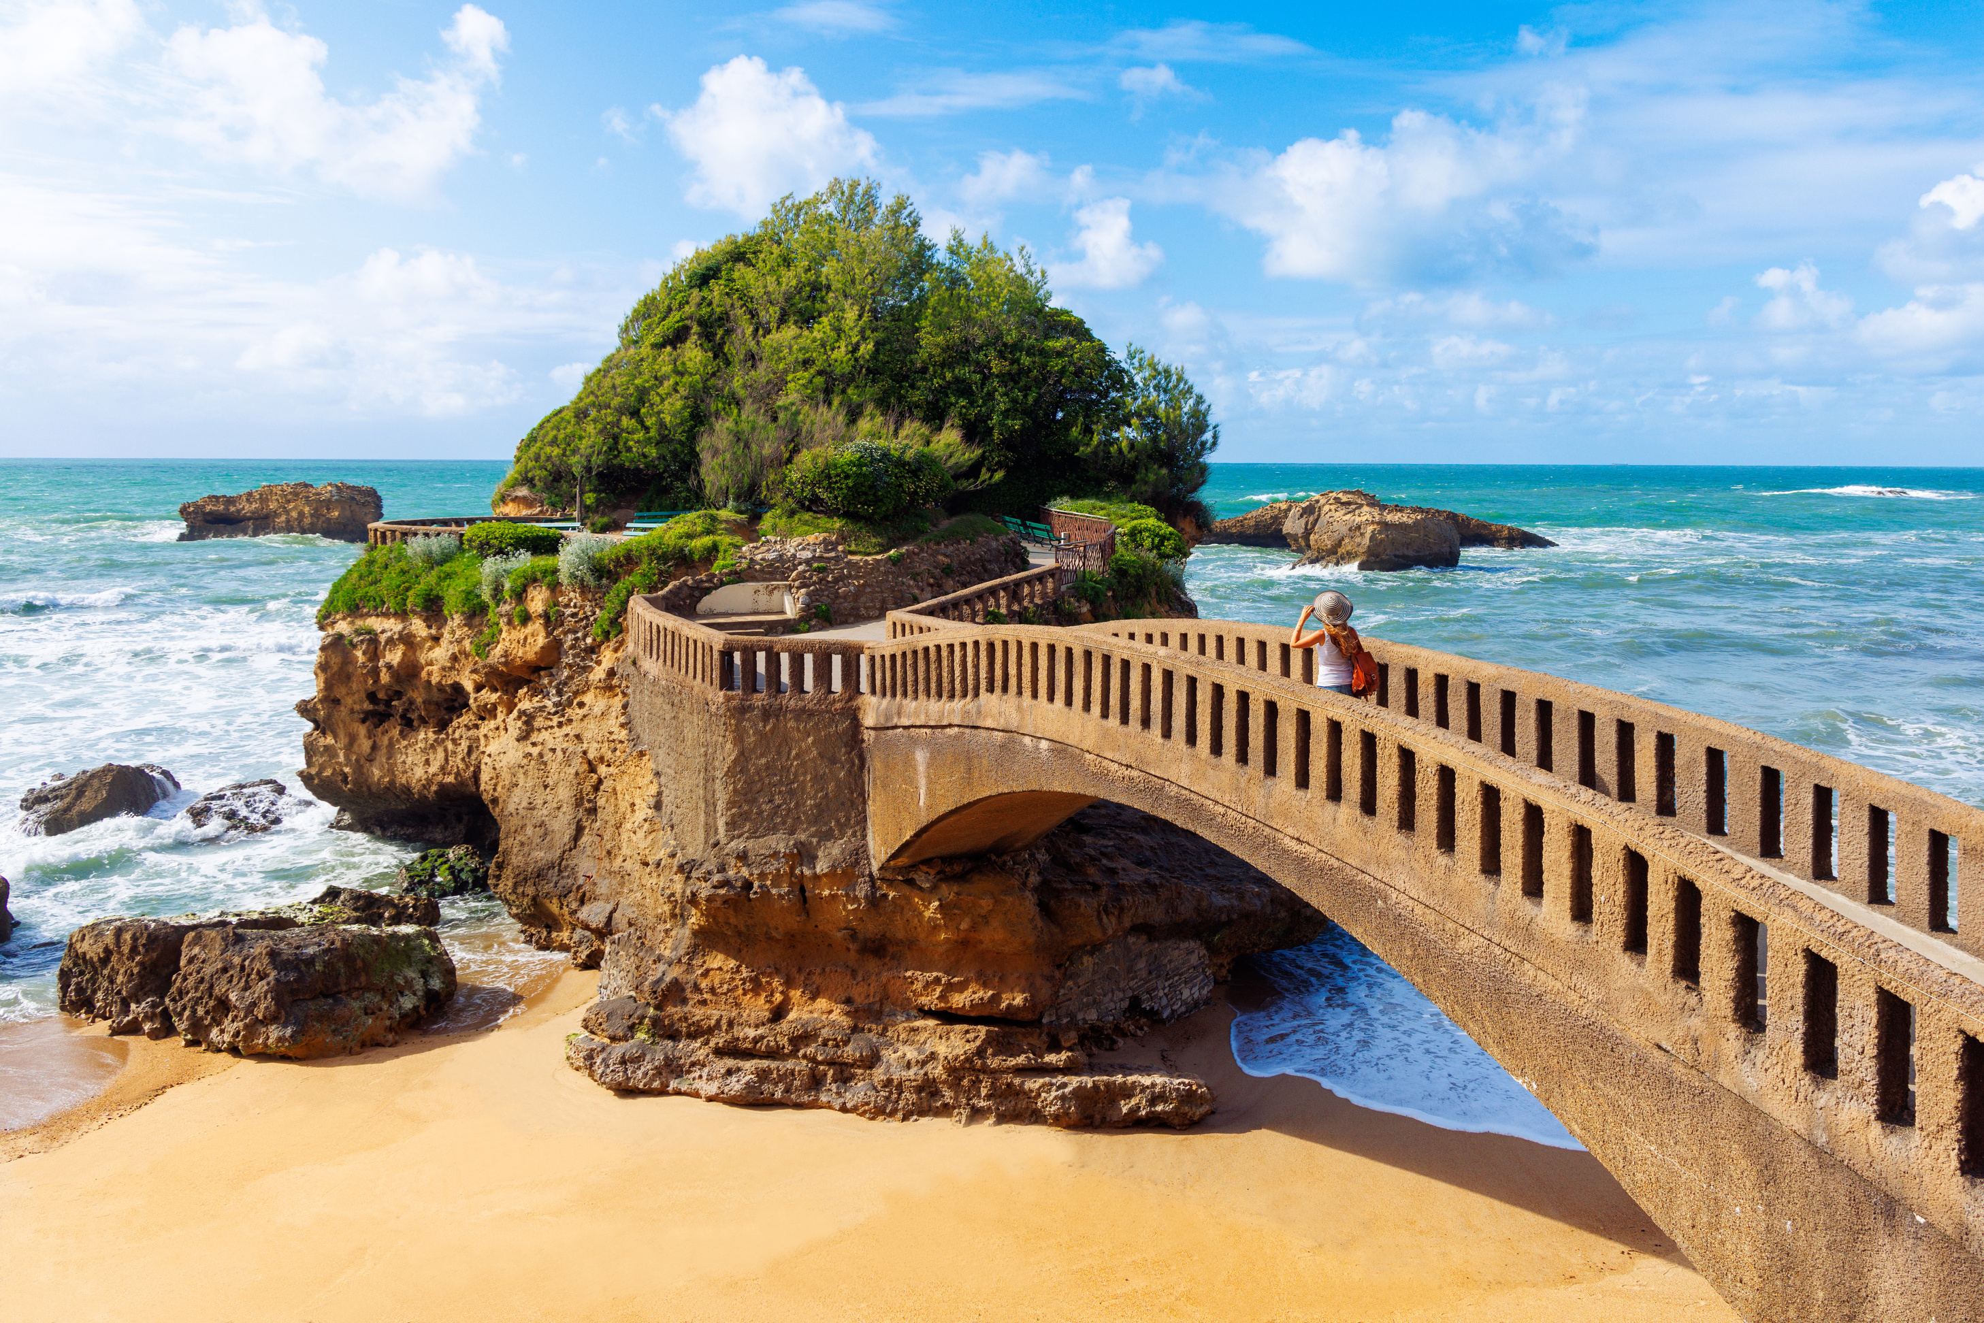
Thank you for
listening

